Slide 1
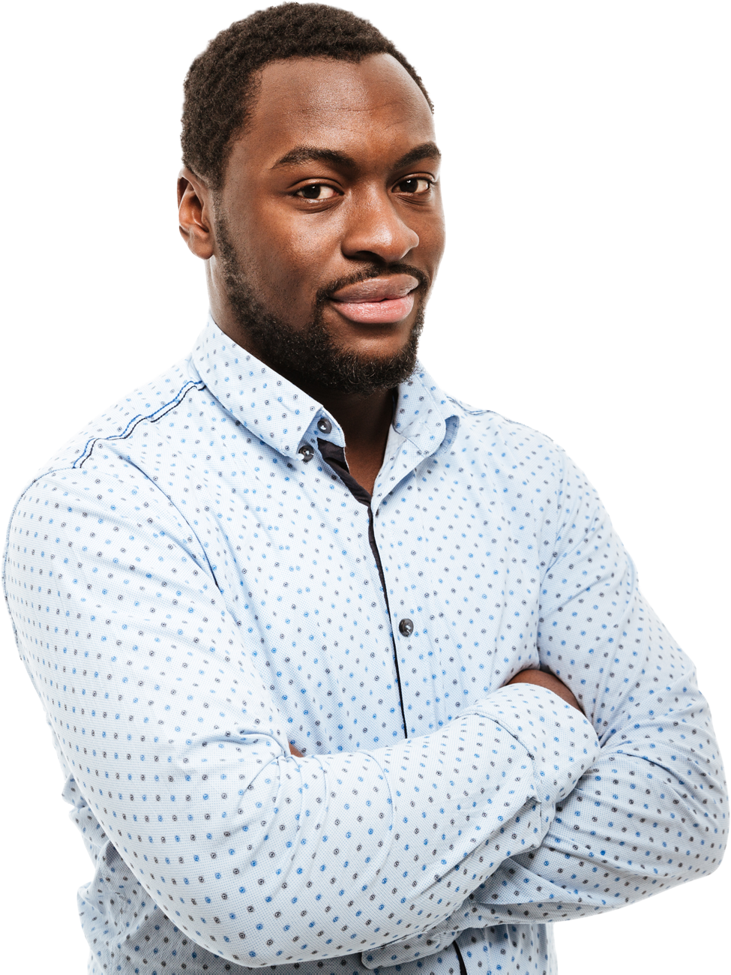
TO BE AN UPSTANDER

Slide 2
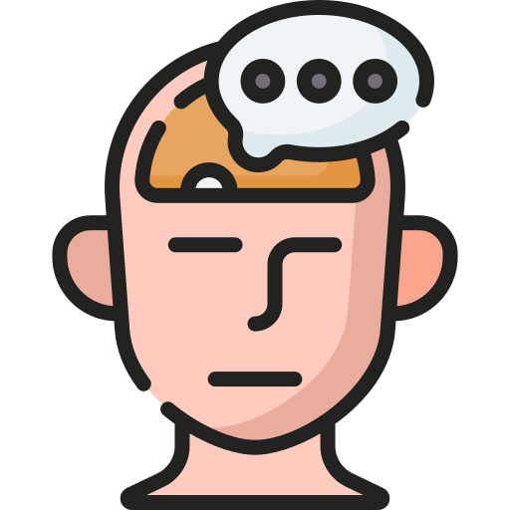
WOULD YOU RATHER
Talk to animals
Hear people’s thoughts

Slide 3
OBJECTIVES
Discuss what it means to be an Upstander
Learn about the 3 Ds of being an Upstander
Reflect on how you can make a choice to be an Upstander

Slide 4
DISCUSSION
Have you ever heard the word "upstander" before?
Do you have any ideas about what it might mean?

Slide 5
WHAT IS AN UPSTANDER?
You always have a choice.
As an upstander, you are choosing to:
Stand up for what you believe in
Stand up in defense of others
Speak up when you see injustice
Support someone who is being mistreated

Slide 6
BECOMING AN UPSTANDER?
https://youtu.be/hoKcIP4TIFo
Notes:
https://youtu.be/hoKcIP4TIFo

Slide 7
D
D
D
THE 3 D’S OF BEING AN UPSTANDER
It can be hard to make a choice to be an upstander if you have never had any practice. Here are some techniques you can try:
D
D
D
Distract
Direct
Delegate

Slide 8
D
D
D
DISTRACT
Interrupt the incident.
Engage directly with one of the parties involved to try to stop the incident.
Distract them from the conflict by changing the subject or suggesting an alternate activity.

Slide 9
D
D
D
DIRECT
Directly ask the person at risk if they are okay. Their response can help you choose your next step.
Some helpful questions:
“Are they bothering you?”
“Do you need any help?”
Name what appears to be happening
Use phrases like “This is not right” or “Hey, let it go!”

Slide 10
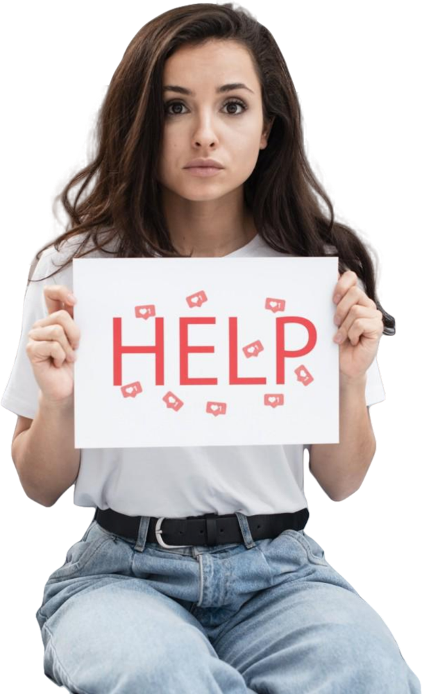
D
D
D
DELEGATE
Not everyone feels comfortable stepping into a conflict. That is OK! You can still choose to help by delegating.
Get some help by letting someone else know what is going on.
Who can help? Find a teacher, administrator, yard support, parent, relative, anyone you trust!
Asking for help is not snitching, it’s making a choice to be an upstander.

Slide 11
DISCUSSION
Which of the 3 D's would you feel most comfortable using?
DISTRACT
DIRECT
DELEGATE

Slide 12
REMEMBER - YOU CAN ONLY CONTROL YOU
You are not responsible for the final outcome of a situation.
Respect others’ choices- try not to take it personally if they don’t react or respond as you would expect.
You make your choices, they make theirs.
But you can make a choice to try to empower others!

Slide 13
MAKING A DIFFERENCE
Notes:
https://youtu.be/7qmA-rp1FV0

Slide 14
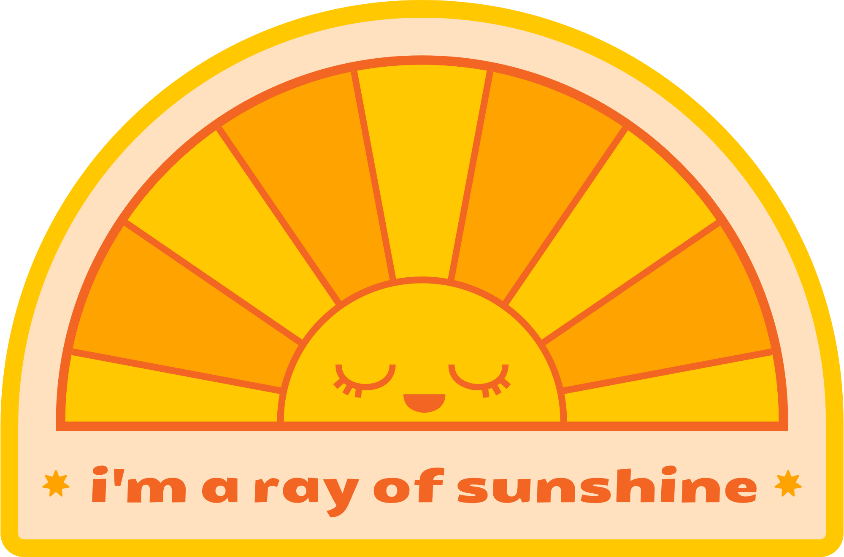
CHECK OUT
Pick an affirmation for the day!

Slide 15
Committed to fostering a safe and respectful District, school and community culture where the seeds of peace and justice are sown so that all students and staff can lead safe, purposeful and academically fruitful lives.
Connect with us at bit.ly/LAUSD-HRDE

